Slide 1
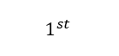
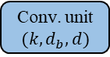
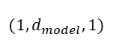
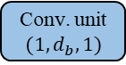


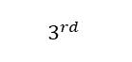

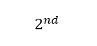
$${\hat{t}}_{l}$$
O
+
Conv. unit
Conv. unit
$$3^{rd}$$
$$(1,d_{model},1)$$
Conv1D
$$B×$$
Conv. unit
$$(k,d_{b},d)$$
$$2^{nd}$$
Layer norm*
Rectifier
Conv. unit
$$(1,d_{b},1)$$
$$1^{st}$$
FC
$$|X_{l}|$$
*no scale or shift

